Slide 1
SEP
User Research
(About us section on live website)
Feb 2020
Anubhav Mittal

Slide 2
Who we tested with
10 Online un-moderated test sessions, with Userzoom panel, for usability testing
Male – 4 / Female - 6

Slide 3
What we were trying to find out
We explored the following things:
Users likes and dislikes about the homepage of findbusinesssupport.gov.scot website
If they felt there was anything missing
Their views about the “About us” section
(URL: https://www.findbusinesssupport.gov.scot/about-us/) and their likes and dislikes

Slide 4
SEP homepage – likes and dislikes
When we asked the users about their likes and dislikes upon looking at the homepage following things were mentioned:
Top 3 likes Top 3 dislikes
1 | 2 | 3
I liked the hero image | I liked the personal touch of the website | I like that it looks semi-professional
Bright and colorful | People posing are smiling | Layout is simple
Very tidy - looks easy to navigate this site. | You know it’s for business in Scotland. | Right away you know what it’s for i.e. to offer support for businesses in Scotland
I liked the office photo with the staff | The browse all support sections button | Task bar simple
I liked the mouse over action for the top menu and footer links | I liked the main image which fit the theme of the website | I liked the semi-transparent black box and the white text which was clearly readable.
I liked the tabs at the top | I like that you could see the search bar (just not in that place) | I liked that it stated it was a government site through the web address.
Simple | User friendly | Easy on the eyes
Professional imagery | Easy to see how to contact | Informative concise text
The color scheme | efficiency (not too much information to overwhelm you) | Felt professional
Page has an organized layout | Usage of photos which makes it more alive and friendly | The page looked genuine and professional
1 | 2 | 3
It looked not so professional | I didn’t like the color scheme | I didn’t like the placing of the items
One large posed photo dominates | Not much informative content | Doesn’t ’hook’ the potential user
The site is far too generic. There’s nothing new and it could be for anything. | The main and only graphic looks like it’s for an advertising agency and not general businesses. | I’m not sure if it’s from the Scottish government or the English based one
The large black box | You couldn’t see the picture of office in back | The cross beside the telephone number
The top left logo | The over large grey footer | Lack of contact number or details
The search box covering the content / landing page | the girl sitting on the floor - no one conducts business in an office sitting on the floor. | Maybe better with smaller pictures
A little boring | Better picture could be nice | A little more information
Having to click through to find information rather than it being accessible on that page | A bit boring | Maybe too simple
The footer was a bit clunky, could have been more efficient | Photo worked well but could possibly be improved | Maybe there could have been a little bit more information present
Not much information provided; | No steps that need to be followed in order to get started available on them main page; | No personal account where I can store my data and my search history

Slide 5
SEP homepage – anything missing?
Things users mentioned when asked if there was anything missing from the homepage:
Top 5 things that are missing
1) | 2) | 3) | 4) | 5)
I didn’t feel that the website is leading me anywhere | logo | chat | Times/days that the phonelines are open | Defined colour scheme
Several smaller real world ’success’ photos of real world businesses | Lack of effective descriptive content. | No testimonials | No indication of regionality (support locations) | No dynamic content
Contact details, phone number | Company registration | cookie consent - gladly missing | Perhaps sparse information, but I can appreciate that this page will be clicked through quite quickly | A professional logo, it appears to be text only with no obvious brand.
Good graphics | Nice tile / home page heading | logo - something recognizable | Short links | I’d prefer to have links to perhaps specific business sizes so you can jump straight to your area
Maybe website reviews (trustpilot etc.) if applicable | A bit more text | help options | banner picture could be a sliding one and change picture every so often. | Header logo could be a bit more pronounced

Slide 6
SEP About us – likes and dislikes
When we asked the users about their likes and dislikes upon looking at the About us section following things were mentioned:
Top 3 likes Top 3 dislikes
1) | 2) | 3)
Informative | Visual hierarchy | Important key points
Gave contact information | Had some descriptive content | Noted that it was for all size businesses
It spells out who came up with the site i.e. it’s a joint enterprise by public bodies in Scotland. | You can submit an inquiry online. | If in doubt, there’s a phone number to call.
Information | Contact details | Who and what organizations
Partnerships, although not of a great deal of use to know. | The section and information is well organized; | They also clearly stated the schedule and phone number.
I liked the links that could be clicked | I liked the content - short and to the point | I liked the lay out of the words and headings
The information is well summarized; | Straight to the point
The companies behind it so you know you can trust the information | Contact information including costs | Why it was set up
Layout of the Q&A section | Information present was good | Color scheme works well
1) | 2) | 3)
Long lines | Lack of white space | It wasn’t an enjoyable way to get the information
Bland, like a magazine page with only text. | No graphics or images to highlight key points | No testimonials or success stories
It doesn’t tell you overall who runs the site. | I don’t think I saw hyperlinks over the names of the public bodies involved in the site so I could click to find out more. | The phrasing is a bit bland and now empowering.
Duplicate contact numbers | Large writing paragraphs could be streamlined | Clunky footer
Layout | Redundant repetition of text | Most of the information seems a little forced and unnecessary
No color | Nothing pictorial / no logo | Very plain font - black would read better.
Bit too plain | Basic | Boring
Repetitive contact information | Page looks boring without imagery | No idea who would be referring - do/should you go through them first?

Slide 7
SEP About us section
When we asked the users to provide their initial feelings and thoughts following was shared:
The layout was very good. I really like the bold text question followed by the answer format. I think that is the best layout style for this type of page. Again, the colour scheme worked well. The information on offer was good but could be improved by offering more details.
The about us section has the detail I would expect. It tells you that the website is from a partnership between different agencies. It doesn’t tell you who exactly runs it though. How will your information be used?
They kept it professional but in the same time they used common words so they will not confuse the audience. The sections are well organised, and you can clearly understand all the information provided without having to read it again.

Slide 8
SEP About us section
Continued …
It was very plain and basic, but it had the content
Quite a dull page. Good that like to contact etc can be clicked. Lots of writing nothing pictorial. Boring but informative.
It was a lot of writing and it could be streamlined. Double up of information is not necessary. It gave lots of information which was missing on front page
Informative and I like that it includes the businesses behind it, so you know the information is trustworthy. The overall page looks a bit bland though and repetitive with the contact information
I felt that it is a wall of text and it made me confused.
I find it bland and uninspiring - a ’text dump’ like it’s from a magazine page.
Poorly laid out, no separation between header and main content. Too little spacing between sub-headings and previous paragraphs. Redundancy in the text that is visible on a single screen.. repetition. Some sub-headings seem a little unnecessary, with text that might be better suited to the homepage or the contact section.

Slide 9
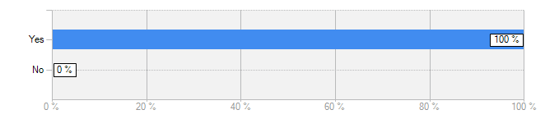
SEP About us section
When we asked the users following question all the users said that the About us section covered everything.
Does this section cover everything that you were expecting to see in the "about us" page on this website?
Answer | Count | Percent
Yes | 10 | 100%
No | 0 | 0%
answered question | 10
In my opinion you shared the most important information’s about yourself
Most of the information is there. I like that it is a good length - not too long and is to the point.
I would have probably add a few images as well or at least, the logos of the partners to make it look more genuine and professional.
Not really, it didn’t tell me much about the brand, and I am still unsure of exactly who is the maintainer... is this a joint venture between local councils or is it an independent Government service.

Slide 10
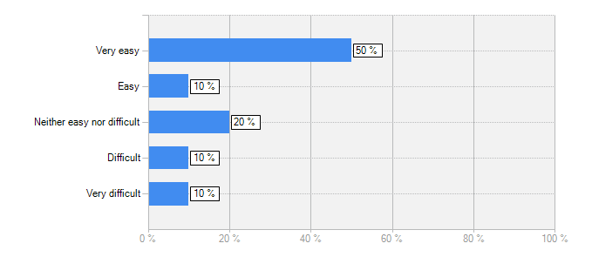
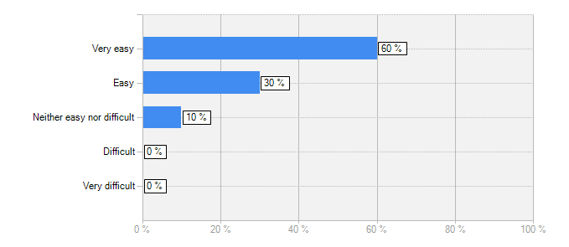
SEP About us section
How easy was it to read the content?
How easy was it to understand the content?
Answer | Count | Percent
Very easy | 5 | 50%
Easy | 1 | 10%
Neither easy nor difficult | 2 | 20%
Difficult | 1 | 10%
Very difficult | 1 | 10%
answered question | 10
“The lines were too long, and it makes difficult the follow them”
“It was understandable text”
Answer | Count | Percent
Very easy | 6 | 60%
Easy | 3 | 30%
Neither easy nor difficult | 1 | 10%
Difficult | 0 | 0%
Very difficult | 0 | 0%
answered question | 10
“The language was plain and simple to understand”

Slide 11
Summary – About us section
Most users found the “about us” section easy to read and understand
They felt that the language was plain and simple and they liked the content. It was concise and informative.
Small no of users, felt the section to be bland, that the lines and paras were too long and found it difficult to follow.
Few commented on the bad formatting, spacing and information being repetitive.
Lack of imagery or graphics, colour, dynamic content, web chat was mentioned as being missing from the about us section.
Others also mentioned it would be good to have partner logos, couple of lines about them and their web links, testimonials (or success stories).
One user was confused about the brand and who ran the website. As it was only one user the Research Team will keep an eye on it.
“Not really, it didn’t tell me much about the brand, and I am still unsure of exactly who is the maintainer.. is this a joint venture between local councils or is it an independent Government service”

Slide 12
Thank you!

